Slide 1
Recurrent Neural Network (RNN)
Notes:
Recurrent Neural Network (RNN) 循环神经网络 (RNN)

Slide 2

Example Application
Slot Filling
I would like to arrive Taipei on November 2nd.
ticket booking system
Destination:
Taipei
Slot
time of arrival:
November 2nd
Notes:
Slot Filling 槽填充
I would like to arrive Taipei on November 2nd. 我想在11月2号到达台北。

Slide 3
Example Application
Solving slot filling by Feedforward network?
Input: a word
(Each word is represented as a vector)
Taipei
Notes:
Feedforward network 前馈网络

Slide 4
1-of-N encoding
How to represent each word as a vector?
1-of-N Encoding
lexicon = {apple, bag, cat, dog, elephant}
The vector is lexicon size.
apple = [ 1 0 0 0 0]
bag = [ 0 1 0 0 0]
Each dimension corresponds to a word in the lexicon
cat = [ 0 0 1 0 0]
The dimension for the word is 1, and others are 0
dog = [ 0 0 0 1 0]
elephant = [ 0 0 0 0 1]
Notes:
Can be very large

Slide 5
Beyond 1-of-N encoding
Dimension for “Other”
Word hashing
apple
0
a-a-a
0
bag
0
a-a-b
0
…
…
cat
0
a-p-p
1
dog
0
…
…
…
26 X 26 X 26
elephant
0
p-l-e
1
…
…
p-p-l
1
“other”
1
…
…
w = “apple”
w = “Gandalf”
w = “Sauron”

Slide 6
Example Application
time of departure
dest
Solving slot filling by Feedforward network?
Input: a word
(Each word is represented as a vector)
Output:
Probability distribution that the input word belonging to the slots
Taipei
Notes:
time of departure 出发时间

Slide 7
Example Application
time of departure
dest
arrive Taipei on November 2nd
other
dest
other
time
time
Problem?
leave Taipei on November 2nd
place of departure
Neural network needs memory!
Taipei
Notes:
arrive Taipei on November 2nd 11月2日抵达台北
leave Taipei on November 2nd 11月2日离开台北
place of departure 出发地

Slide 8
Recurrent Neural Network (RNN)
The output of hidden layer are stored in the memory.
store
Memory can be considered as another input.

Slide 9
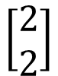
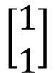
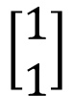
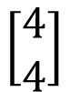
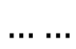
Example
Input sequence:
$$\left[\begin{aligned}1 \\ 1\end{aligned}\right]$$
$$\left[\begin{aligned}1 \\ 1\end{aligned}\right]$$
$$\left[\begin{aligned}2 \\ 2\end{aligned}\right]$$
$$……$$
output sequence:
$$\left[\begin{aligned}4 \\ 4\end{aligned}\right]$$
4
4
store
2
2
given Initial values
0
0
All the weights are “1”, no bias
1
1
All activation functions are linear

Slide 10
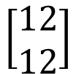
Example
Input sequence:
$$\left[\begin{aligned}1 \\ 1\end{aligned}\right]$$
$$\left[\begin{aligned}1 \\ 1\end{aligned}\right]$$
$$\left[\begin{aligned}2 \\ 2\end{aligned}\right]$$
$$……$$
output sequence:
$$\left[\begin{aligned}4 \\ 4\end{aligned}\right]$$
$$\left[\begin{aligned}12 \\ 12\end{aligned}\right]$$
12
12
store
6
6
2
2
All the weights are “1”, no bias
1
1
All activation functions are linear

Slide 11
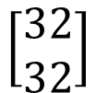
Example
Input sequence:
$$\left[\begin{aligned}1 \\ 1\end{aligned}\right]$$
$$\left[\begin{aligned}1 \\ 1\end{aligned}\right]$$
$$\left[\begin{aligned}2 \\ 2\end{aligned}\right]$$
$$……$$
output sequence:
$$\left[\begin{aligned}4 \\ 4\end{aligned}\right]$$
$$\left[\begin{aligned}12 \\ 12\end{aligned}\right]$$
$$\left[\begin{aligned}32 \\ 32\end{aligned}\right]$$
Changing the sequence order will change the output.
32
32
store
16
16
6
6
All the weights are “1”, no bias
2
2
All activation functions are linear

Slide 12
RNN
The same network is used again and again.
Probability of “arrive” in each slot
Probability of “Taipei” in each slot
Probability of “on” in each slot
y¹
y²
y³
store
store
a¹
a²
a³
a¹
a²
x¹
x²
x³
arrive Taipei on November 2nd
Notes:
General idea

Slide 13
RNN
Different
Prob of “leave” in each slot
Prob of “Taipei” in each slot
Prob of “arrive” in each slot
Prob of “Taipei” in each slot
y²
……
y²
……
y¹
y¹
store
store
a¹
a²
a¹
a²
a¹
……
a¹
……
x¹
x²
……
x¹
x²
……
leave
Taipei
arrive
Taipei
The values stored in the memory is different.
Notes:
Output y^{i} depends on x¹, x², …… x^{i}
The same input can have totoally different output.

Slide 14
Of course it can be deep …
y^{t}
y^{t+1}
y^{t+2}
……
……
……
……
……
……
……
……
……
x^{t}
x^{t+1}
x^{t+2}

Slide 15
Elman Network & Jordan Network
Elman Network
Jordan Network
y^{t}
y^{t+1}
y^{t}
y^{t+1}
W^{h}
Wº
Wº
Wº
Wº
……
……
……
……
W^{h}
W^{i}
W^{i}
W^{i}
W^{i}
x^{t}
x^{t+1}
x^{t}
x^{t+1}

Slide 16
Bidirectional RNN
……
x^{t}
x^{t+1}
x^{t+2}
……
y^{t}
y^{t+1}
y^{t+2}
……
……
x^{t}
x^{t+1}
x^{t+2}
Notes:
Bidirectional RNN 双向 RNN
RNN 有什么问题？为什么还需要 LSTM？
因为 RNN 存在梯度消失和梯度爆炸的问题，LSTM 可以解决梯度消失的问题
在 LSTM 训练时，设置较小的学习率也可以解决梯度爆炸的问题
gradient vanish 梯度消失
gradient explode 梯度爆炸

Slide 17
Long Short-term Memory (LSTM)
Other part of the network
Special Neuron:
4 inputs,
1 output
Signal control the output gate
Output Gate
(Other part of the network)
Memory
Cell
Forget Gate
Signal control the forget gate
(Other part of the network)
Signal control the input gate
Input Gate
LSTM
(Other part of the network)
Other part of the network
Notes:
Long Short-term Memory (LSTM) 长短期记忆（LSTM）

Slide 18
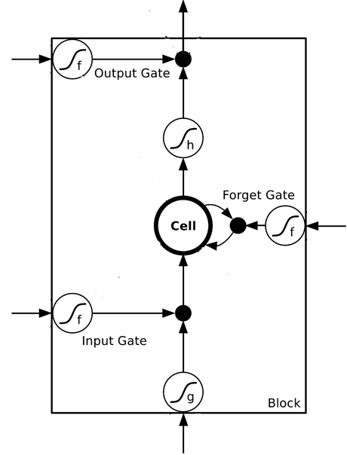
$$a$$
$$=h\left(c^{′}\right)f\left(z_{o}\right)$$
$$z_{o}$$
multiply
Activation function f is usually a sigmoid function
$$f\left(z_{o}\right)$$
$$h\left(c^{′}\right)$$
Between 0 and 1
Mimic open and close gate
$$c$$
$$f\left(z_{f}\right)$$
c
$$c^{′}$$
$$z_{f}$$
$$cf\left(z_{f}\right)$$
$$c^{′}=g\left(z\right)f\left(z_{i}\right)+cf\left(z_{f}\right)$$
$$f\left(z_{i}\right)$$
$$g\left(z\right)f\left(z_{i}\right)$$
$$z_{i}$$
multiply
$$g\left(z\right)$$
$$z$$

Slide 19
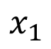
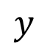
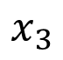
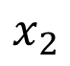
LSTM - Example
0
0
3
3
7
7
7
0
6
$$x_{1}$$
1
0
0
3
1
0
2
0
0
4
1
0
2
0
0
1
0
1
3
-1
0
6
1
0
1
0
1
$$x_{2}$$
$$x_{3}$$
$$y$$
0
0
0
0
0
7
0
0
6
When x₂ = 1, add the numbers of x₁ into the memory
When x₂ = -1, reset the memory
When x₃ = 1, output the number in the memory.
Notes:
Can you find the rule?

Slide 20
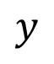
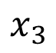
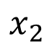
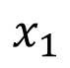
x₁
0
y
$$y$$
0
0
0
7
0
x₂
0
+
x₃
100
0
x₁
1
-10
100
0
0
+
x₂
x₁
0
x₃
x₂
100
+
10
1
x₃
0
1
-10
+
$$x_{1}$$
3
1
0
4
1
0
2
0
0
1
0
1
3
-1
0
1
0
0
0
$$x_{2}$$
x₁
x₂
x₃
1
$$x_{3}$$
Notes:
When x2 = 1, add the numbers of x1 into the memory
When x2 = -1, reset the memory
When x3 = 1, output the number in the memory.

Slide 21
3
0
≈0
y
$$y$$
0
0
0
7
0
1
0
+
≈0
3
0
100
0
3
1
-10
0
100
0
3
+
1
3
≈1
0
0
100
≈1
3
1
+
10
1
3
0
0
1
-10
+
$$x_{1}$$
3
1
0
4
1
0
2
0
0
1
0
1
3
-1
0
1
0
0
0
$$x_{2}$$
3
1
0
1
$$x_{3}$$

Slide 22
4
0
≈0
y
$$y$$
0
0
0
7
0
1
0
+
≈0
7
0
100
0
4
1
-10
7
100
0
3
+
1
4
≈1
0
0
100
≈1
4
1
+
10
1
4
0
0
1
-10
+
$$x_{1}$$
3
1
0
4
1
0
2
0
0
1
0
1
3
-1
0
1
0
0
0
$$x_{2}$$
4
1
0
1
$$x_{3}$$

Slide 23
2
0
≈0
y
$$y$$
0
0
0
7
0
0
0
+
≈0
7
0
100
0
2
1
-10
7
100
0
+
0
2
≈1
0
0
100
≈0
0
0
+
10
1
2
0
0
1
-10
+
$$x_{1}$$
3
1
0
4
1
0
2
0
0
1
0
1
3
-1
0
1
0
0
0
$$x_{2}$$
2
0
0
1
$$x_{3}$$

Slide 24
1
0
≈7
y
$$y$$
0
0
0
7
0
0
0
+
≈1
7
1
100
0
1
1
-10
7
100
0
+
0
1
≈1
0
1
100
≈0
0
0
+
10
1
1
1
0
1
-10
+
$$x_{1}$$
3
1
0
4
1
0
2
0
0
1
0
1
3
-1
0
1
0
0
0
$$x_{2}$$
1
0
1
1
$$x_{3}$$

Slide 25
3
0
≈0
y
$$y$$
0
0
0
7
0
-1
0
+
≈0
0
0
100
0
3
1
-10
0
100
0
7
+
-1
3
≈0
0
0
100
≈0
0
-1
+
10
1
3
0
0
1
-10
+
$$x_{1}$$
3
1
0
4
1
0
2
0
0
1
0
1
3
-1
0
1
0
0
0
$$x_{2}$$
3
-1
0
1
$$x_{3}$$

Slide 26
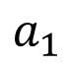
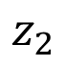
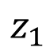
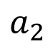
Original Network:
Simply replace the neurons with LSTM
……
……
$$a_{1}$$
$$a_{2}$$
$$z_{1}$$
$$z_{2}$$
x₁
x₂
Input
Notes:
Use a same set of information
Note about the memory

Slide 27
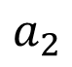
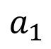
$$a_{1}$$
$$a_{2}$$
+
+
+
+
+
+
+
+
4 times of parameters
x₁
x₂
Input
Notes:
Use a same set of information
Note about the memory

Slide 28
LSTM
c^{t-1}
……
vector
z^{f}
z^{i}
z
zº
4 vectors
x^{t}
Notes:
Identiy
C is vector

Slide 29

LSTM
y^{t}
zº
c^{t-1}
$$×$$
$$＋$$
$$×$$
z^{f}
$$×$$
z^{i}
z^{f}
z^{i}
z
zº
x^{t}
z
Notes:
Identiy
C is vector

Slide 30
LSTM
Extension: “peephole”
y^{t}
y^{t+1}
c^{t-1}
c^{t}
c^{t+1}
$$×$$
$$＋$$
$$×$$
$$×$$
$$＋$$
$$×$$
$$×$$
$$×$$
z^{f}
z^{i}
z
zº
z^{f}
z^{i}
z
zº
c^{t-1}
h^{t-1}
x^{t}
c^{t}
h^{t}
x^{t+1}
Notes:
Identiy
C is vector

Slide 31
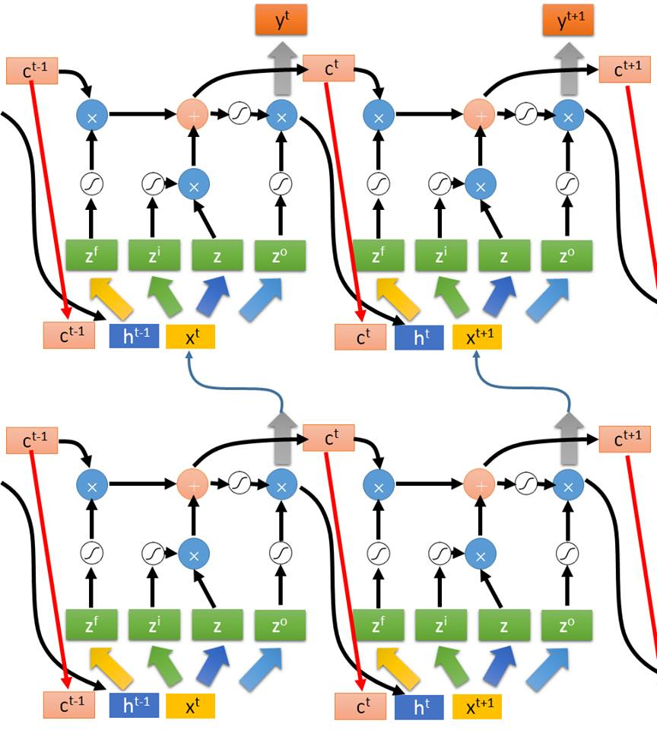
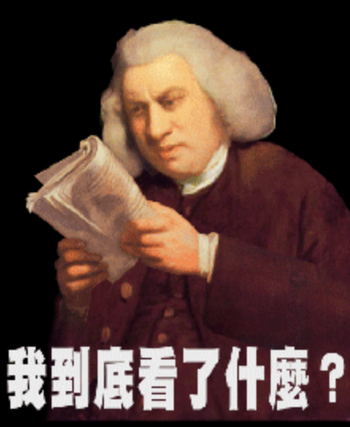
Multiple-layer
LSTM
Don’t worry if you cannot understand this. Keras can handle it.
Keras supports
“LSTM”, “GRU”, “SimpleRNN” layers
This is quite standard now.
https://img.komicolle.org/2015-09-20/src/14426967627131.gif
Notes:
Usually when people say RNN, they mean LSTM!

Slide 32
Learning Target
other
dest
other
0
…
1
…
0
…
…
…
…
0
1
0
0
1
0
y¹
y²
y³
copy
copy
a¹
a²
a³
a¹
a²
W^{i}
x¹
x²
x³
Training
Sentences:
arrive Taipei on November 2nd
other
dest
other
time
time
Notes:
General idea

Slide 33
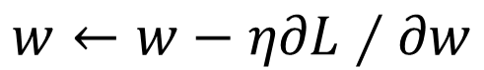

Learning
Backpropagation through time (BPTT)
copy
$$w$$
$$w←w−η∂L∕∂w$$

Slide 34
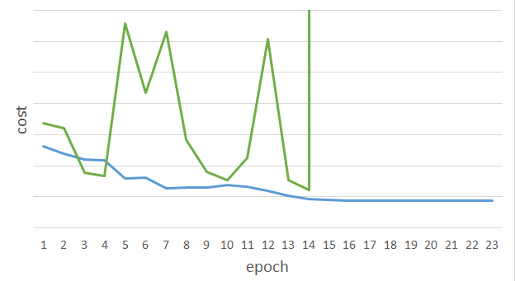
Unfortunately ……
感謝 曾柏翔 同學
提供實驗結果
RNN-based network is not always easy to learn
Real experiments on Language modeling
sometimes
Total Loss
Lucky
Epoch
Notes:
Not because you have bug haha

Slide 35
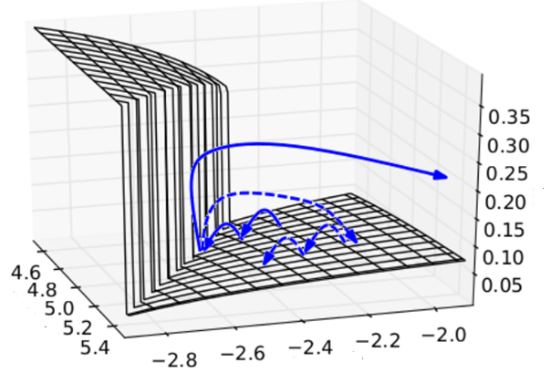

The error surface is rough.
The error surface is either very flat or very steep.
Clipping
Cost
Total Loss
w₂
w₁
[Razvan Pascanu, ICML’13]
Notes:
Even adagrad can not handle this problem, maybe RMS prop is better
Source: http://jmlr.org/proceedings/papers/v28/pascanu13.pdf
Large or small is fine. Change quickly is bad
RNN 有什么问题？为什么还需要 LSTM？
因为 RNN 存在梯度消失和梯度爆炸的问题，LSTM 可以解决梯度消失的问题
在 LSTM 训练时，设置较小的学习率也可以解决梯度爆炸的问题
gradient vanish 梯度消失
gradient explode 梯度爆炸

Slide 36
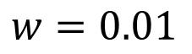
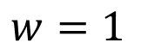
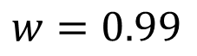
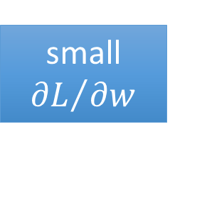
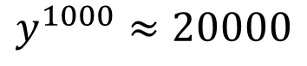
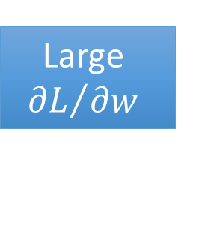
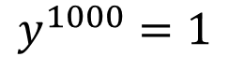
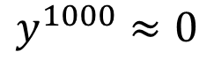
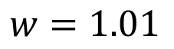
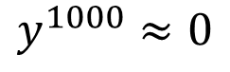
Why?
$$w=1$$
$$y^{1000}=1$$
Large
$${∂L}/{∂w}$$
Small Learning rate?
$$w=1.01$$
$$y^{1000}≈20000$$
$$w=0.99$$
$$y^{1000}≈0$$
small ${∂L}/{∂w}$
Large Learning rate?
$$w=0.01$$
$$y^{1000}≈0$$
=w⁹⁹⁹
y¹
y²
y³
y¹⁰⁰⁰
Toy Example
1
1
1
1
……
w
w
w
1
1
1
1
1
0
0
0
Notes:
Gradient Explode/Gradient Vanishing
Echo state network -> …..

Slide 37
Helpful Techniques
Long Short-term Memory (LSTM)
Can deal with gradient vanishing (not gradient explode)
Memory and input are added
The influence never disappears unless forget gate is closed
No Gradient vanishing
add
(If forget gate is opened.)
Gated Recurrent Unit (GRU):
simpler than LSTM
[Cho, EMNLP’14]
Notes:
Reference: http://colah.github.io/posts/2015-08-Understanding-LSTMs/
为什么 LSTM 可以解决梯度消失的问题？
因为 RNN 每次都会把 memory 里面的值替换，而 LSTM 是将 input 值加上原来 memory 里面的值，也就是说通过调整 weight 之后对 memory 里面的值的影响是一致都在的
GRU 和 LSTM 相比，就相当于只有两个 gate，因为 GRU 将 input gate 和 forget gate 联动起来。
当 input gate 开启时，forget gate 就关闭
当 input gate 关闭时，forget gate 就开启

Slide 38
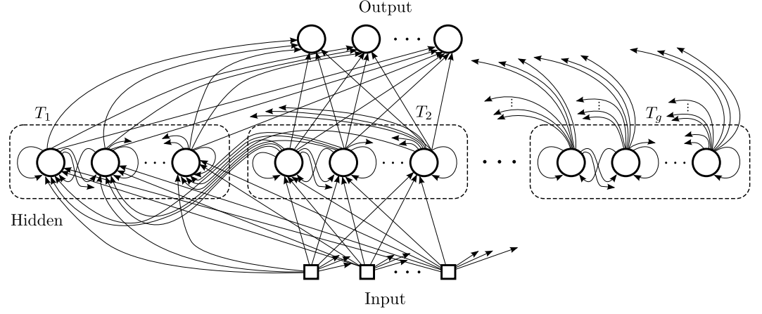
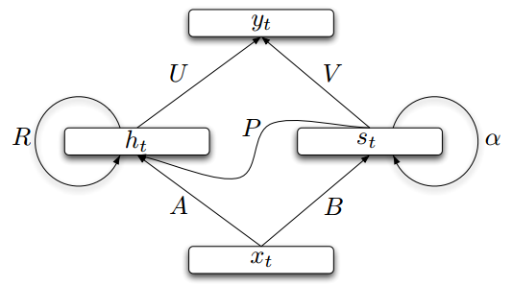
Helpful Techniques
Structurally Constrained Recurrent Network (SCRN)
Clockwise RNN
[Jan Koutnik, JMLR’14]
[Tomas Mikolov, ICLR’15]
Vanilla RNN Initialized with Identity matrix + ReLU activation function [Quoc V. Le, arXiv’15]
Outperform or be comparable with LSTM in 4 different tasks
Notes:
Gated Recurrent Unit (GRU):
http://www.wildml.com/2015/10/recurrent-neural-network-tutorial-part-4-implementing-a-grulstm-rnn-with-python-and-theano/
Structurally Constrained Recurrent Network (SCRN).
Cloclwise RNN

Slide 39
More Applications ……
Probability of “arrive” in each slot
Probability of “Taipei” in each slot
Probability of “on” in each slot
y¹
y²
y³
Input and output are both sequences with the same length
store
store
a¹
a²
a³
a¹
a²
RNN can do more than that!
x¹
x²
x³
arrive Taipei on November 2nd

Slide 40
Many to one
Input is a vector sequence, but output is only one vector
Sentiment Analysis
超好雷
好雷
看了這部電影覺得很高興 …….
這部電影太糟了
…….
這部電影很棒 …….
普雷
負雷
Positive (正雷)
Negative (負雷)
Positive (正雷)
超負雷
……
我
覺
得
……
太
糟
了

Slide 41
Many to one
[Shen & Lee, Interspeech 16]
Input is a vector sequence, but output is only one vector
O_{T}
Key Term
Extraction
…
Key Terms:
DNN, LSTN
V₁
V₂
V₃
V₄
…
V_{T}
Output Layer
document
Embedding Layer
x₁
x₂
x₃
x₄
…
x_{T}
Hidden Layer
Embedding Layer
V₁
V₂
V₃
V₄
V_{T}
Σα_{i}V_{i}
…
α₁ α₂ α₃ α₄ … α_{T}

Slide 42
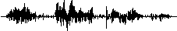
Many to Many (Output is shorter)
Both input and output are both sequences, but the output is shorter.
E.g. Speech Recognition
Output:
“好棒”
(character sequence)
Problem?
Trimming
Why can’t it be “好棒棒”
好
好
好
棒
棒
棒
棒
棒
(vector
sequence)
Input:

Slide 43
Many to Many (Output is shorter)
Both input and output are both sequences, but the output is shorter.
Connectionist Temporal Classification (CTC) [Alex Graves, ICML’06][Alex Graves, ICML’14][Haşim Sak, Interspeech’15][Jie Li, Interspeech’15][Andrew Senior, ASRU’15]
“好棒”
Add an extra symbol “φ” representing “null”
“好棒棒”
好
φ
φ
棒
φ
φ
φ
φ
好
φ
φ
棒
φ
棒
φ
φ
Notes:
English is successful, ASRU’15 better than HMM + N-gram

Slide 44
Many to Many (Output is shorter)
CTC: Training
好
φ
棒
φ
φ
φ
Acoustic
Features:
好
φ
φ
棒
φ
φ
Label:
好
棒
All possible alignments are considered as correct.
好
φ
φ
φ
棒
φ
……

Slide 45
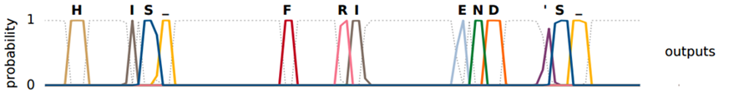
Many to Many (Output is shorter)
CTC: example
HIS FRIEND’S
φ
φ
φ
φ
φ
φ
φ
φ
φ
φ
φ
φ
φ
φ
φ
φ
φ
Graves, Alex, and Navdeep Jaitly. "Towards end-to-end speech recognition with recurrent neural networks." Proceedings of the 31st International Conference on Machine Learning (ICML-14). 2014.

Slide 46
Many to Many (No Limitation)
Both input and output are both sequences with different lengths. → Sequence to sequence learning
E.g. Machine Translation (machine learning→機器學習)
Containing all information about input sequence
machine
learning
Notes:
中翻英 英翻中 沒有哪一個一定比較長或比較短

Slide 47
Many to Many (No Limitation)
Both input and output are both sequences with different lengths. → Sequence to sequence learning
E.g. Machine Translation (machine learning→機器學習)
機
器
學
習
慣
性
……
……
machine
learning
Don’t know when to stop
Notes:
中翻英 英翻中 沒有哪一個一定比較長或比較短

Slide 48
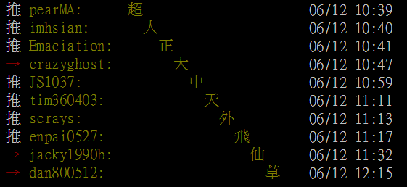
Many to Many (No Limitation)
推 tlkagk: =========斷==========
接龍推文是ptt在推文中的一種趣味玩法，與推齊有些類似但又有所不同，是指在推文中接續上一樓的字句，而推出連續的意思。該類玩法確切起源已不可知(鄉民百科)
Notes:
推文接龍

Slide 49
Many to Many (No Limitation)
Both input and output are both sequences with different lengths. → Sequence to sequence learning
E.g. Machine Translation (machine learning→機器學習)
機
器
學
習
===
machine
learning
Add a symbol “===“ (斷)
[Ilya Sutskever, NIPS’14][Dzmitry Bahdanau, arXiv’15]
Notes:
中翻英 英翻中 沒有哪一個一定比較長或比較短
More applications

Slide 50
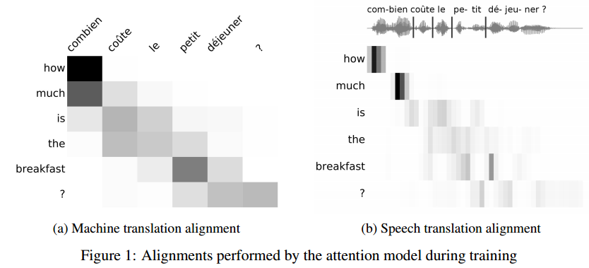
Many to Many (No Limitation)
https://arxiv.org/pdf/1612.01744v1.pdf
Both input and output are both sequences with different lengths. → Sequence to sequence learning
E.g. Machine Translation (machine learning→機器學習)

Slide 51
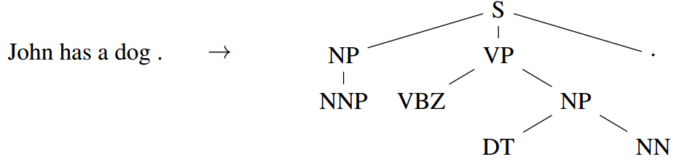
Beyond Sequence
Syntactic parsing
john
has
a
dog
Oriol Vinyals, Lukasz Kaiser, Terry Koo, Slav Petrov, Ilya Sutskever, Geoffrey Hinton, Grammar as a Foreign Language, NIPS 2015

Slide 52
Sequence-to-sequence Auto-encoder - Text
To understand the meaning of a word sequence, the order of the words can not be ignored.
white blood cells destroying an infection
positive
different
meaning
exactly the same bag-of-word
an infection destroying white blood cells
negative
Notes:
傳染病 infection

Slide 53
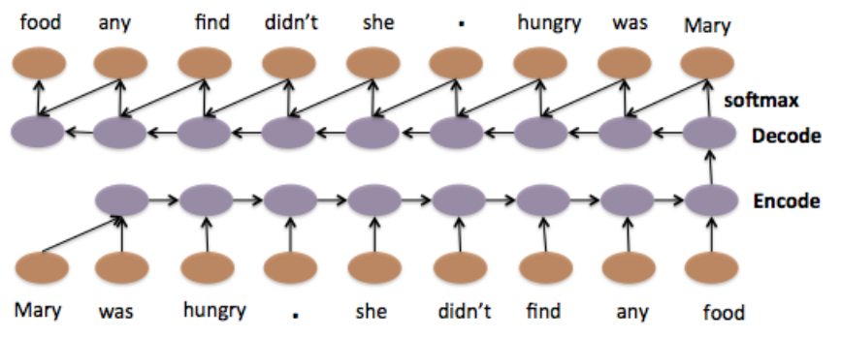
Sequence-to-sequence Auto-encoder - Text
Li, Jiwei, Minh-Thang Luong, and Dan Jurafsky. "A hierarchical neural autoencoder for paragraphs and documents." arXiv preprint arXiv:1506.01057(2015).

Slide 54
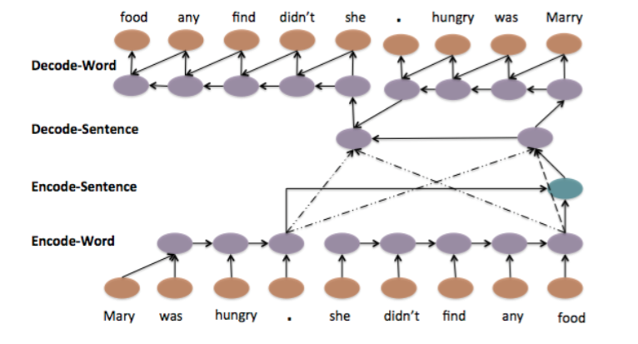
Sequence-to-sequence Auto-encoder - Text
Li, Jiwei, Minh-Thang Luong, and Dan Jurafsky. "A hierarchical neural autoencoder for paragraphs and documents." arXiv preprint arXiv:1506.01057(2015).

Slide 55
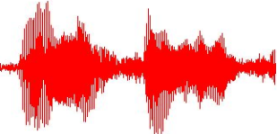

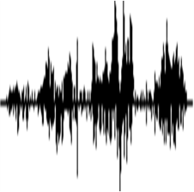
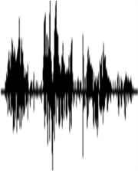

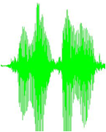
Sequence-to-sequence Auto-encoder - Speech
Dimension reduction for a sequence with variable length
audio segments (word-level)
Fixed-length vector
dog
never
dog
never
Yu-An Chung, Chao-Chung Wu, Chia-Hao Shen,
Hung-Yi Lee, Lin-Shan Lee, Audio Word2Vec: Unsupervised Learning of Audio Segment Representations using Sequence-to-sequence Autoencoder, Interspeech 2016
dogs
never
ever
ever
Notes:
With coloer

Slide 56




Sequence-to-sequence Auto-encoder - Speech
Audio archive divided into variable-length audio segments
Off-line
Audio Segment to Vector
Audio Segment to Vector
Similarity
Spoken Query
On-line
Search Result

Slide 57

Sequence-to-sequence Auto-encoder - Speech
vector
audio segment
RNN Encoder
The values in the memory represent the whole audio segment
The vector we want
How to train RNN Encoder?
x₁
x₂
x₃
x₄
acoustic features
audio segment

Slide 58
Sequence-to-sequence Auto-encoder
Input acoustic features
x₁
x₂
x₃
x₄
The RNN encoder and decoder are jointly trained.
y₁
y₂
y₃
y₄
RNN Encoder
RNN Decoder
x₁
x₂
x₃
x₄
acoustic features
audio segment

Slide 59


Sequence-to-sequence Auto-encoder - Speech
Visualizing embedding vectors of the words
fear
fame
name
near

Slide 60

Demo: Chat-bot
電視影集 (~40,000 sentences)、美國總統大選辯論
Notes:
Will you build a wall?

Slide 61

Demo: Chat-bot
Develop Team
Interface design: Prof. Lin-Lin Chen & Arron Lu
Web programming: Shi-Yun Huang
Data collection: Chao-Chuang Shih
System implementation: Kevin Wu, Derek Chuang, & Zhi-Wei Lee (李致緯), Roy Lu (盧柏儒)
System design: Richard Tsai & Hung-Yi Lee
Notes:
What do you think of Global Warming? Will you build a wall Do you like machine learning?
Do you like ML?
http://140.115.51.134:8080/clark/test.php

Slide 62






Demo: Video Caption Generation
A girl is running.
Video
A group of people is knocked by a tree.
A group of people is walking in the forest.

Slide 63
Demo: Video Caption Generation
Can machine describe what it see from video?
Demo: 台大語音處理實驗室 曾柏翔、吳柏瑜、盧宏宗
Video: 莊舜博、楊棋宇、黃邦齊、萬家宏
Notes:
http://140.112.21.26/video2text/

Slide 64

Demo: Image Caption Generation
Input an image, but output a sequence of words
[Kelvin Xu, arXiv’15][Li Yao, ICCV’15]
A vector for whole image
a
woman
is
===
CNN
……
Input image
Caption Generation
Notes:
A woman is throwing a Frisbee in a part.

Slide 65
Demo: Image Caption Generation
Can machine describe what it see from image?
Demo:台大電機系 大四 蘇子睿、林奕辰、徐翊祥、陳奕安
MTK 產學大聯盟
Notes:
http://140.112.21.35:14000/index.html

Slide 66

http://news.ltn.com.tw/photo/politics/breakingnews/975542_1

Slide 67

Attention-based Model
What you learned in these lectures
Breakfast today
What is deep learning?
summer vacation 10 years ago
Organize
Answer
http://henrylo1605.blogspot.tw/2015/05/blog-post_56.html

Slide 68
Attention-based Model
Input
DNN/RNN
output
Reading Head Controller
Reading Head
……
……
Machine’s Memory
Ref: http://speech.ee.ntu.edu.tw/~tlkagk/courses/MLDS_2015_2/Lecture/Attain%20(v3).ecm.mp4/index.html
Notes:
Need an example …… ok, in the future

Slide 69
Attention-based Model v2
Input
DNN/RNN
output
Reading Head Controller
Writing Head Controller
Writing Head
Reading Head
……
……
Machine’s Memory
Neural Turing Machine
Notes:
Need an example …… ok, in the future

Slide 70

Reading Comprehension
Query
DNN/RNN
answer
Reading Head Controller
Semantic Analysis
……
……
Each sentence becomes a vector.

Slide 71

Reading Comprehension
End-To-End Memory Networks. S. Sukhbaatar, A. Szlam, J. Weston, R. Fergus. NIPS, 2015.
The position of reading head:
Keras has example: https://github.com/fchollet/keras/blob/master/examples/babi_memnn.py

Slide 72

Visual Question Answering
source: http://visualqa.org/
Notes:
太陽花梗

Slide 73

Visual Question Answering
Query
DNN/RNN
answer
Reading Head Controller
CNN
A vector for each region

Slide 74

Speech Question Answering
TOEFL Listening Comprehension Test by Machine
Example:
(The original story is 5 min long.)
Audio Story:
Question: “ What is a possible origin of Venus’ clouds? ”
Choices:
(A) gases released as a result of volcanic activity
(B) chemical reactions caused by high surface temperatures
(C) bursts of radio energy from the plane's surface
(D) strong winds that blow dust into the atmosphere

Slide 75

Model Architecture
Everything is learned from training examples
Answer
…… It be quite possible that this be due to volcanic eruption because volcanic eruption often emit gas. If that be the case volcanism could very well be the root cause of Venus 's thick cloud cover. And also we have observe burst of radio energy from the planet 's surface. These burst be similar to what we see when volcano erupt on earth ……
Select the choice most similar to the answer
Attention
Attention
Question Semantics
Semantic Analysis
Speech Recognition
Semantic Analysis
Question:
Audio Story:
“what is a possible origin of Venus‘ clouds?"
Notes:
Mamery network proposed by FB’s AI team

Slide 76

Simple Baselines
Experimental setup:
717 for training,
124 for validation, 122 for testing
(2) select the shortest choice as answer
(4) the choice with semantic most similar to others
Accuracy (%)
random
(1)
(2)
(3)
(4)
(5)
(6)
(7)
Naive Approaches

Slide 77
Memory Network
Memory Network: 39.2%
(proposed by FB AI group)
Accuracy (%)
(1)
(2)
(3)
(4)
(5)
(6)
(7)
Naive Approaches

Slide 78
Proposed Approach
[Tseng & Lee, Interspeech 16]
[Fang & Hsu & Lee, SLT 16]
Proposed Approach: 48.8%
Memory Network: 39.2%
(proposed by FB AI group)
Accuracy (%)
(1)
(2)
(3)
(4)
(5)
(6)
(7)
Naive Approaches

Slide 79
To Learn More ……
The Unreasonable Effectiveness of Recurrent Neural Networks
http://karpathy.github.io/2015/05/21/rnn-effectiveness/
Understanding LSTM Networks
http://colah.github.io/posts/2015-08-Understanding-LSTMs/

Slide 80
Deep & Structured

Slide 81


RNN v.s. Structured Learning
RNN, LSTM
Unidirectional RNN does not consider the whole sequence
Cost and error not always related
Deep
HMM, CRF, Structured Perceptron/SVM
Using Viterbi, so consider the whole sequence
How about Bidirectional RNN?
Can explicitly consider the label dependency
Cost is the upper bound of error
?

Slide 82

Integrated Together
HMM, CRF, Structured Perceptron/SVM
Explicitly model the dependency
Deep
Cost is the upper bound of error
RNN, LSTM
http://photo30.bababian.com/upload1/20100415/42E9331A6580A46A5F89E98638B8FD76.jpg

Slide 83



Integrated together
Speech Recognition: CNN/LSTM/DNN + HMM
$$P\left(x,y\right)=P\left( y_{1}|start\right)\prod_{l=1}^{L−1}{P\left(y_{l+1}|y_{l}\right)}P\left(end|y_{L}\right)\prod_{l=1}^{L}{P\left(x_{l}|y_{l}\right)}$$
P(a|x_{l})
P(b|x_{l})
P(c|x_{l})
……
$$P\left(x_{l}|y_{l}\right)=\frac{P\left(x_{l},y_{l}\right)}{P\left(y_{l}\right)}$$
……
RNN
……
……
RNN
$$=\frac{P\left(y_{l}|x_{l}\right)P\left(x_{l}\right)}{P\left(y_{l}\right)}$$
……
x_{l}
……
Count

Slide 84


Integrated together
Semantic Tagging: Bi-directional LSTM + CRF/Structured SVM
……
……
$$w∙φ\left(x,y\right)$$
……
……
RNN
……
……
Testing:
RNN
$$\tilde{y}=arg\max_{y∈𝕐}{\text{w}\text{∙}φ\text{(}\text{x}\text{,}\text{y}\text{)}}$$
……
……
Notes:
Training
Mesnil, G., Dauphin, Y., Kaisheng Yao, Bengio, Y., Li Deng, Hakkani-Tur, D., Xiaodong He, Heck, L., Tur, G., Dong Yu, Zweig, G., "Using Recurrent Neural Networks for Slot Filling in Spoken Language Understanding," in Audio, Speech, and Language Processing, IEEE/ACM Transactions on , vol.23, no.3, pp.530-539, March 2015

Slide 85
Is structured learning practical?
Problem 3: you know how to learn F(x)
Considering GAN
Real x
Noise
From
Gaussian
Generator
Discri-minator
x
1/0
Generated
Inference:
Evaluation Function
F(x)
Problem 2
Problem 1

Slide 86
Is structured learning practical?
Real
(x,y) pair
Conditional GAN
Generator
Discri-minator
x
y
1/0
x

Slide 87
Sounds crazy? People do think in this way …
Deep and Structured will be the future.
Connect Energy-based model with GAN:
A Connection Between Generative Adversarial Networks, Inverse Reinforcement Learning, and Energy-Based Models
Deep Directed Generative Models with Energy-Based Probability Estimation
ENERGY-BASED GENERATIVE ADVERSARIAL NETWORKS
Deep learning model for inference
Deep Unfolding: Model-Based Inspiration of Novel Deep Architectures
Conditional Random Fields as Recurrent Neural Networks

Slide 88


Machine learning and having it deep and structured (MLDS)
和 ML 的不同
在這學期 ML 中有提過的內容 (DNN, CNN …)，在 MLDS 中不再重複，只做必要的復習
教科書： “Deep Learning” (http://www.deeplearningbook.org/)
Part II 是講 deep learning 、Part III 就是講 structured learning

Slide 89
Machine learning and having it deep and structured (MLDS)
所有作業都 2 ~ 4 人一組，可以先組好隊後一起來修
MLDS 的作業和之前不同
RNN (把之前 MLDS 的三個作業合為一個)、Attention-based model 、Deep Reinforcement Learning 、Deep Generative Model 、Sequence-to-sequence learning
MLDS 初選不開放加簽，以組為單位加簽，作業0的內容是做一個 DNN （可用現成套件）

